Slide 1
Decision making in uncertain times
How to become comfortable being uncomfortable
Hans Læssøe
AKTUS Risk Advisory

Slide 2

Presenting myself
Danish, 66 with four children and four grandchildren
M.Sc. in Electrical Power Engineering
35 years of broad LEGO Group experience
  2 years in IT
  13 years in Supply Chain
  4 years in Product Development
  6 years in Finance
  10 years in Strategic Risk Management
Started AKTUS risk advisory April 2017
  AKTUS = “AKTiv USikkerhed” (i.e. Active Uncertainties)
  Uncertainties are facts of life … you may as well learn to manage these to your benefit
  In a volatile world, manoeuvrability is a competitive advantage
Notes:
The essence of my story is, that when I was asked to look into “strategic risk management”, I had no clue about what that was – but I did have:
25 years of LEGO Group experience
A huge internal network
A willingness to try something new
An intimate insight of company “dynamics”
A good business understanding
A history/track record of starting something new, successfuly
All of which helped me get started.
I also attended courses to learn about this before I was “up and running” and supplemented by entering European and US/Global networks.

Slide 3
Agenda
Reporting and
follow through
Analysing and prioritising
what is important, what is not
Identification and evaluation of uncertainties
Decisions
and how to affect them
Decisions
and how to affect them

Slide 4
Purpose of risk management
Risk management must enhance business performance
It is not about:
Managing risks
Predicting the future
Avoiding or minimizing risks
Insurance
It is about:
Business performance
Being prepared for the future
Taking risks … intelligently
Supporting bold decision making
“If everything is under control, you are moving too slow” _{Mario Andretti}
Notes:
Risk management is NOT about managing risks, odd as it may seem.
It is about enhancing business performance … as is the case with most functions in the company (why else would you have them)

Slide 5
Decisions are made in various ways
Strategic
Operational
Standardised
Notes:
These three types of decisions are:
Very different, and hence must be handled differently
Not extremely precisely defined (hence, the deliberate overlap)

Slide 6
Postpone dealing with operational decisions
Operational
Day to day
All levels
Well known
Many
Simple
Limited consequences
Made fast
Decision makers can, validly, rely on experience
⬇
Some day – make decision makers think:
“What may happen, and what do I do about that”
Notes:
Characteristics:
There are tons of them, daily
Most are “no brainers” or have limited consequences
The decision base is mostly uncomplicated and well know
They are made fast
Decision makers can, validly, rely on experience
Yet …
Some day … ask/train/coach/nudge decision makers to think about: “What may happen, and what do I do about that”

Slide 7
Standard process decisions can often be enhanced
Standardised
Repetitive
Defined decision process
Data driven
Examples:
Sales & Operations Planning
Budgeting
Characteristics:
Defined frequency
Specific data
Supported by specialists
May include massive investment decisions
Decisions are “sanctioned” by executives
Notes:
These are present in almost all types of organisations
The process defines the decisions to be made
The executives involved then “approve” these decisions rather than being the ones making them

Slide 8
Adding value to standard process decisions
Standardised
Repetitive
Defined decision process
Data driven
Embedding risk management
Liaise with process driver
Invite yourself to listen and learn
Focus on how uncertainties are addressed
How can risk management improve on decision making
Prepare and suggest
Help and support implementation
Notes:
Embedding risk management
Liaise with process owner/driver
Invite yourself into the process – explicitly with the purpose of listening and learning
Look, listen and learn, focusing on how uncertainties are being dealt with
Ask questions to enhance your understanding
Contemplate if and how your risk management approach may improve on decision making
Prepare and suggest to process owner/driver
Help and support implementation – do not own the outcome

Slide 9
Strategic decisions are politically made …
Strategic
“Ad hoc”
Major initiatives
Two step decisions
What …
Made by executives
Happening “whenever” – fast or slow
A political process
Based on perceptions
Not defined tangibly enough to “go do”
⬇
You will not be invited
If you were, how would you contribute?
Notes:
Bear in mind:
There is nothing sinister, wrong or Machiavellian about political processes.
These happen whenever and wherever:
Different people with
Different backgrounds
Different insights
Different priorities
Need to agree on a shared decision

Slide 10
… and your value is added in implementation
Strategic
“Ad hoc”
Major initiatives
Two step decisions
How …
Made by employees
Based on the “what”
Predictable
Frames and targets
Decision document
⬇
Your colleagues/peers
Focused on validity
Can be influenced
Notes:
Help the team implementing
Help the project owner making a valid business case document, which does include addressing uncertainties, risks and levers,
Help the project manager prepare a valid plan that does embed uncertainties, as well as the risks and levers not planned for

Slide 11
Agenda
Reporting and
follow through
Analysing and prioritising
what is important, what is not
Identification and evaluation
of uncertainties
Identification and evaluation
of uncertainties
Effectively affect decisions by focusing on implementation

Slide 12
Identification and evaluation comes in three steps
Targeting
Identification
Evaluation

Slide 13
Getting the “real” target is pivotal for effectiveness
Questions to ask
How does this enhance performance?
How do you measure outcome performance?
What is success and failure?
Targeting
Notes:
Questions to ask
How does this initiative enhance organisational performance?
More revenue
Less costs
More operational speed/agility
Less CO₂ emission
…
How do you measure outcome performance?
May be multiple parameters, some of which may be “frames” to work within
Be certain you have a SMART target
What is success and failure?
Managerial decisions you are allowed to ask for

Slide 14
You do not manage what you have not seen
Look for
  Risks
  Levers
  Uncertainties
Leverage the methods you already know well
  Brainstorming
  Interviewing
  Bow Tie analyses
  Pre-Mortems
  Scenarios
  Subject Matter Expert insights
Identification
Notes:
Look for all categories
Risks
Levers
Uncertainties
Pursuing an opportunity may be as valuable as mitigating/controlling a risk
Leverage the methods you already know well
Brainstorming
Interviewing
Bow Tie analyses
Pre-Mortems
Scenarios
Subject Matter Expert insights

Slide 15
Evaluation is quantified in performance metrics
Approach
Quantified in terms of performance metrics
Leverage data
Define likelihood
Define outcome range
Evaluation
Notes:
Approach for each uncertainty, risk and lever
Quantified in terms of performance metrics
Could be multiple (e.g. time/money)
Focus on initiative performance
Leverage data when you have them (and you do). Human evaluations are biased
Define likelihood
Define outcome range
Best (plausible) outcome
Most likely outcome
Worst (plausible) outcome
assuming it does happen

Slide 16
Identification and evaluation comes in three steps
Targeting
Identification
Evaluation
How does this decision enhance performance?
How do you measure outcome performance?
What is success?
What is failure?
Risks, levers and uncertainties
Brainstorms
Bow Tie analyses
Pre-mortems
Scenarios
…
Quantified in terms of performance metrics
Leverage data when available
Likelihood
Outcome range
  Best case
  Most likely
  Worst case

Slide 17
Agenda
Reporting and
follow through
Analysing and prioritising
what is important, what is not
Analysing and prioritising
what is important, what is not
Comprehensive identification and quantitative evaluation is the base for valid prioritization
Effectively affect decisions by focusing on implementation

Slide 18
Monte Carlo Simulation as a methodology
Named after the Casino de Monte Carlo
Using empirical analytics when formulas do not work
First used by a British WWI prisoner, finding decimals of π
Computers made this commonly available in the 1960’s
Many technical professions have used this regularly for decades … apparently not risk management
Today a plethora of software packages can do this easily – often as add-ons to Excel
  @Risk
  ModelRisk
  Crystal Ball
  … and they all have great tutorial videos and examples
Nothing magical … just a modelling tool
Notes:
Just a bit of background.
Monte Carlo simulation by no means new
Widely used in many industries
Insurance companies will use this to settle prices
Monte Carlo simulation is a tool which is a pivotal to a risk manager as a screwdriver is to a carpenter.

Slide 19
Modelling your initiative
Find the spreadsheet
Highlight all embedded assumptions
Include risks and levers
Run the Monte Carlo simulation and address results
Notes:
Find the spreadsheet
Someone “always” has a spreadsheet model and a schedule for the initiative
Find it and get access to it (make a copy)
Highlight all embedded assumptions
Add uncertainties (best case, expected case, worst case) to each of these
Include risks and levers
Define likelihood for each of these materializing during timeframe
Define worst, expected, and best case data for each of these
Run the Monte Carlo simulation and address results
Resulting outcome ranges
Impact (Tornado) diagrams

Slide 20
From calculation to modelling
This will be a normal type calculation
We know this is not correct:
  Sales will not be 100 mio. NZD
  Product Engineering will not hit 8,0 mio NZD
  Something unplanned for will happen
  etc.
Yet, this is often the base, decisions are made upon
Especially in the building industry, overruns are (much) more likely than not
As risk professionals, we can help management get a valid decision base …
… by embedding risks, levers and uncertainties
Notes:
Just a dummy example … The model behind will be made available to you

Slide 21
From calculation to modelling
Notes:
When modelling you will have many distributions to chose from. Simplify your life at select a few you will need.
Likelihood:
Bernoulli – it may happen, once
Poisson – it may happen, even more than once
Impact
Pert – skewed distribution
Normal – balanced distribution (not very normal)
Triangular – VERY simple, not that far off
The accuracy of your distributions and descriptions is often less important for decision outcome than you think – so relax.

Slide 22
We can now “play” the project 10,000 times
Notes:
A typical outcome projection.
Outcome is a range/a distribution – not a single point estimate
28,6% likelihood to meet targeted profit of 33 mio NZD
16,3% chance profits will be below minimum threshold of 25 mio NZD
Is that acceptable?
Note the long tail

Slide 23
Key uncertainties are “given” from the simulation
Notes:
This is the “tornado” diagram or a sensitivity analysis.
The name emerges from the typical shape of this
Do not worry about the values (that is complex math – the outcome range if/when a single parameter is changed by one standard deviation) – focus on – wider bar = bigger importance
Most impactful uncertainty is the level of sales
Then, the potential of a market surge
… we have to prepare for this …
Look deeper into revenues

Slide 24
Deep diving into sales outcome
Notes:
You can do the same (modelling) on timing/scheduling or any other performance metric you are applying.
Naturally, if/when you model 3-5 targets simultaneously, the model will be more complex – so start with one.
35% likelihood we will sell below targeted 90 mio NZD
If we wish to secure 98% delivery service, we need capacity to meet 127 mio NZD
This will often be new, tangible and actionable insights to management

Slide 25
Plan the work, and then work the plan
Simulate
decision
model
Happy ?
Go ahead
Yes
What are key uncertainties
Decide on handling actions
Update
decision
model
No
This is a planning cycle

Slide 26
Agenda
Reporting and
follow through
Reporting and
follow through
Leveraging the insights you already have and Monte Carlo simulation will add value
Comprehensive identification and quantitative evaluation is the base for valid prioritization
Effectively affect decisions by focusing on implementation

Slide 27

Risk matrices do not help decision making
Risk focused rather than performance focused
Levers and uncertainties are generally not considered
Evaluated based on single point estimates
Consolidation is not an option
Does not tell the likelihood of meeting targets
Notes:
Heatmaps are risk focused rather than performance focused
Management focus on performance …
... as they should
The cynical leaders hear “excuses” when you say “risks”
Levers and uncertainties are generally not considered
Outcome is destined to be overly negative
Deliberate pursuit of levers not seen as an option
Individual risks are evaluated based on single point estimates
Known to be invalid
The worst of these are based on qualitative scores
Consolidation is not an option – what is worse. 1 red risk or 25 yellow?
Does not tell you anything about the likelihood of meeting targets

Slide 28
Report initiative performance to management
Decision documents are single point estimates
You can communicate a valid outcome range
Now report the likelihood of:
  Meeting or exceeding targets
  Exceeding minimal acceptance level
  Failing
… which invokes good discussions with management
Notes:
Decision documents are often based on single point estimates
You now know and can communicate a valid outcome range for the decision
With SMART targets, you will benefit from also knowing “what is acceptable”
Now report the likelihood of:
Meeting or exceeding targets
Exceeding minimal acceptance level
Failing
… which invokes good discussions with management

Slide 29
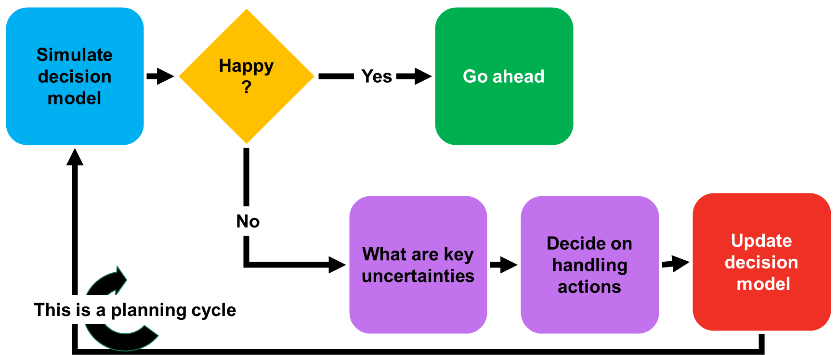
Follow through and update – be the project heads best friend
Keep model updated
Follow through
Report continuously on likelihood of meeting targets
Be the best support to successful implementation you possibly can
Notes:
As the project/implementation progresses
Some risks/levers will materialize, others will not
Some data becomes known
New, formerly unidentified issues emerge
Follow through in collaboration with project leader
Update performance models
Re-simulate
Rework the plan as needed
Report on new status
Be the best support to successful implementation you possibly can – and add real value

Slide 30
Summing Up
Report on performance and redo/update as project progresses
Leveraging the insights you already have and Monte Carlo simulation will add value
Comprehensive identification and quantitative evaluation is the base for valid prioritization
Effectively affect decisions by focusing on implementation

Slide 31
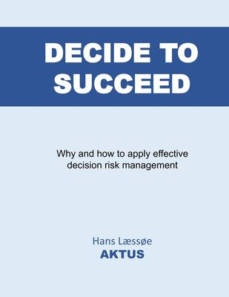
Thank You
Should you wish to dig deeper:
The presentation as well as the reference model used is available to you
The reference model is used @Risk from Palisades as Monte Carlo tool
https://aktus.dk
Decide to Succeed booklet

Slide 32

Questions, Please

